Slide 1
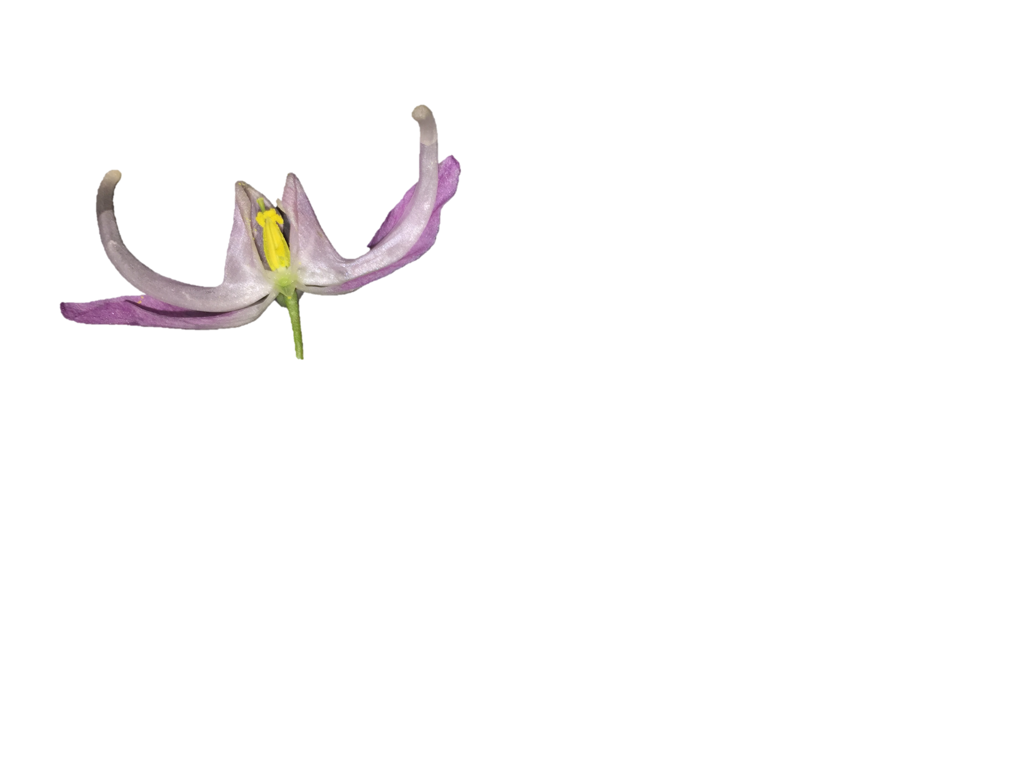
1.
2.
arc length
versine
chord length
chord length
3.
4.
ϴ
R
Notes:
Figure 1

Slide 2
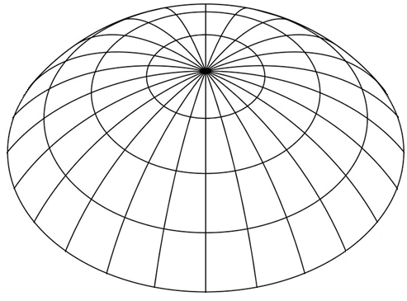

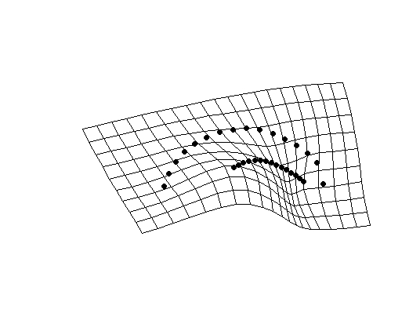
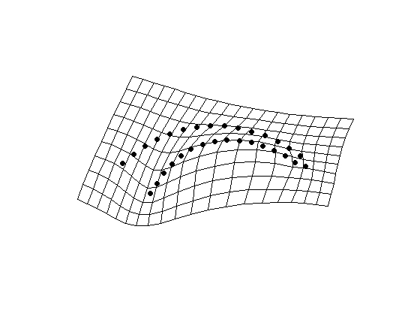
1.
y
2.
x
PC2
3.
PC1
Notes:
Landmarks and semi-landmarks are assigned to a specimen with each point having an (xy) coordinate.
For each specimen, a configuration of landmarks exists as a single point in a non-Euclidian shape space (abstracted here as a simple sphere). Red points represent landmark configurations from other specimens.
Shape data is projected onto a Euclidian plane – a tangent space approximation. This allows statistical analyses of shape variation (e.g. principal components analysis).

Slide 3

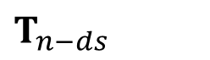
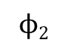
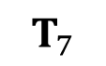
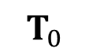
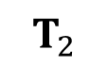

y
Δs
$$T_{7}$$
$$ϕ n−ds$$
$$T_{2}$$
$T_{n−ds}$
$$ϕ\text{2}$$
$$T_{n}$$
s = 2
$$T_{0}$$
s = 1
s = 0
x
Notes:
Figure 3

Slide 4
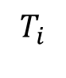
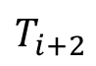
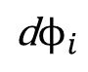
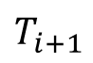
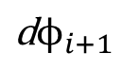
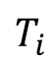
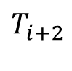
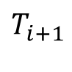
y
y
1.
2.
x
x
4.
3.
$$T_{i}$$
$$T_{i+1}$$
$$T_{i}$$
ds
$$T_{i+1}$$
$$T_{i+2}$$
$$T_{i+2}$$
$${\text{d}ϕ}_{i}$$
$${\text{d}ϕ}_{i+1}$$
Notes:
Figure 4

Slide 5
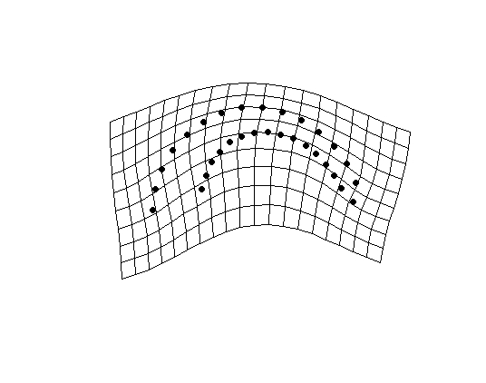
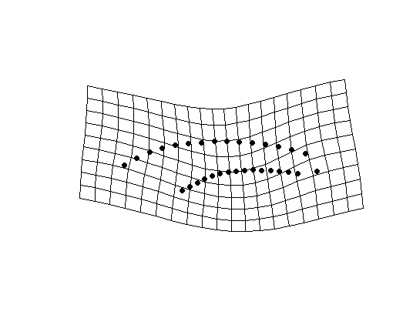
PC1 of shape space (25.6 %)
Species
E. koreanum
E. violaceum
total curvature (degrees)

Slide 6
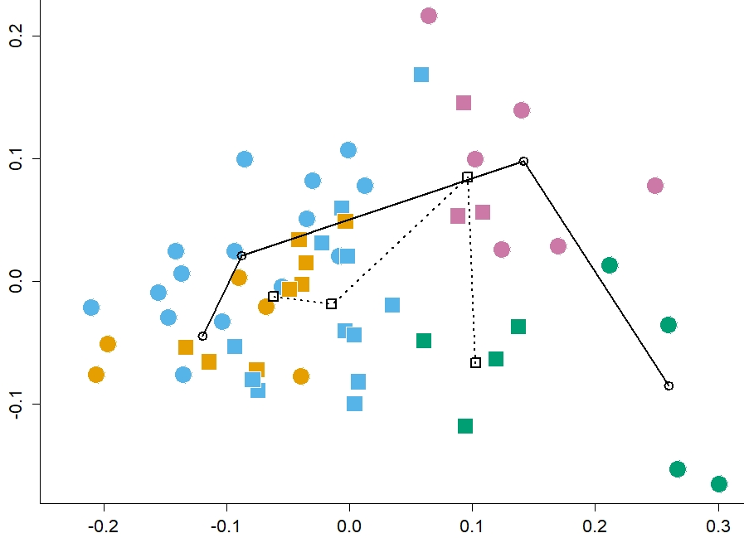
PC2 of shape space (25.6 %)
Stages
C
G
T
A
PC1 of shape space (61.4%)
Species
E. koreanum
E. violaceum

Slide 7
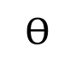
y
r (s)
r’ (s)
y’ (s)
$$ϴ$$
x’ (s)
x
Notes:
Figure 11

Slide 8
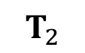
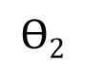
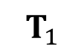
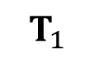
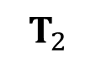
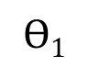
$$T_{2}$$
y
y
$$T_{1}$$
$$T_{2}$$
$$T_{1}$$
$$ϴ\text{2}$$
$$ϴ\text{1}$$
x
x
Notes:
Figure 12

